Slide 1
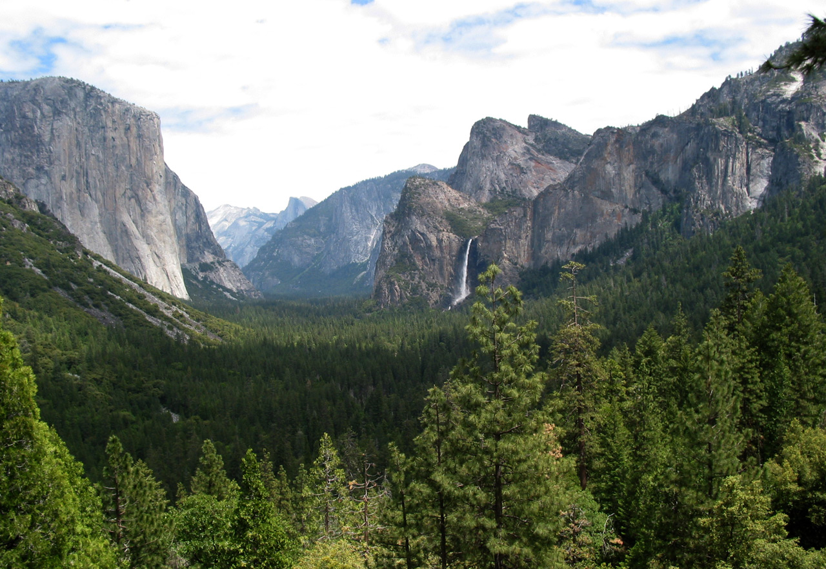
Notes:
John Muir described Yosemite Valley as “by far the grandest of all the special temples of Nature I was ever permitted to enter.” Coming from the “Father of America’s National Parks”, that’s saying a lot.

Slide 2
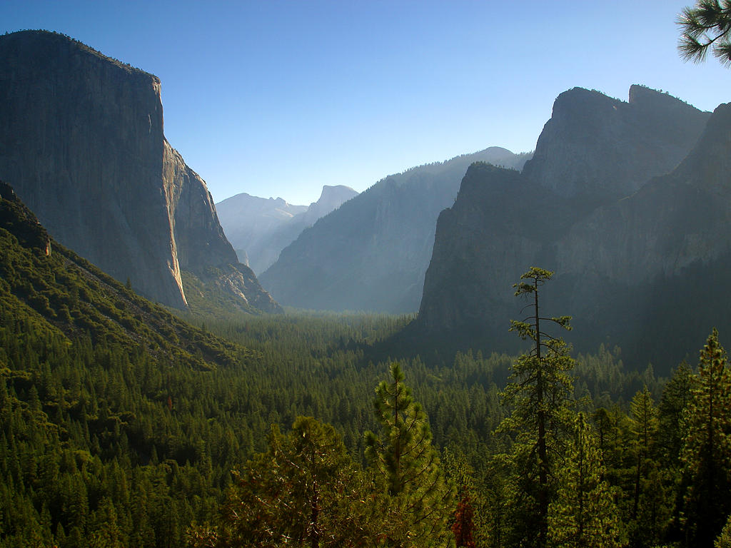
Notes:
The famed naturalist and ecologist had a decent understanding of geology and was perhaps the first to propose that this magnificent valley was carved by glaciers. Indeed there is perhaps no finer place in the world to see the artistry that glaciers have worked on granite.

Slide 3
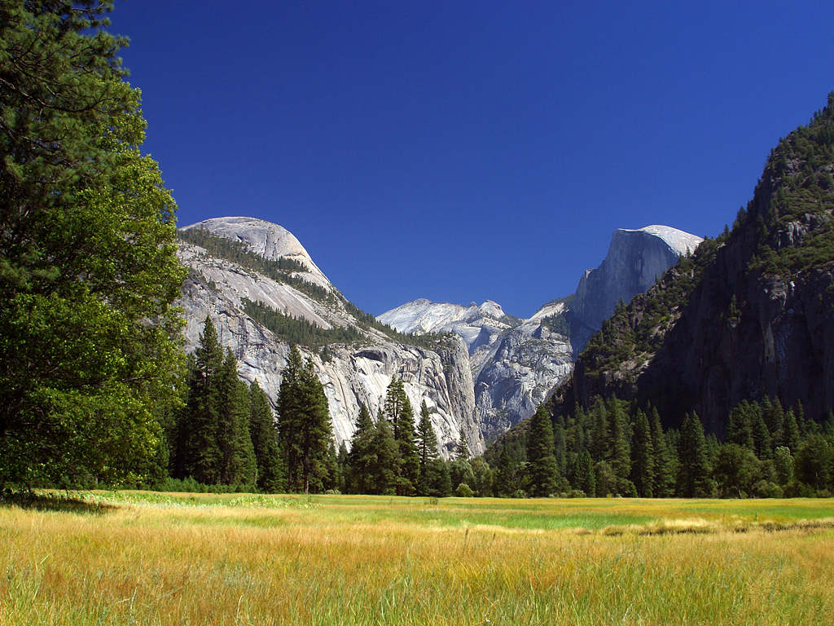
Notes:
We’ll cover Yosemite’s glacial processes in due time, but first let’s have a look at where all that beautiful granite came from.

Slide 4
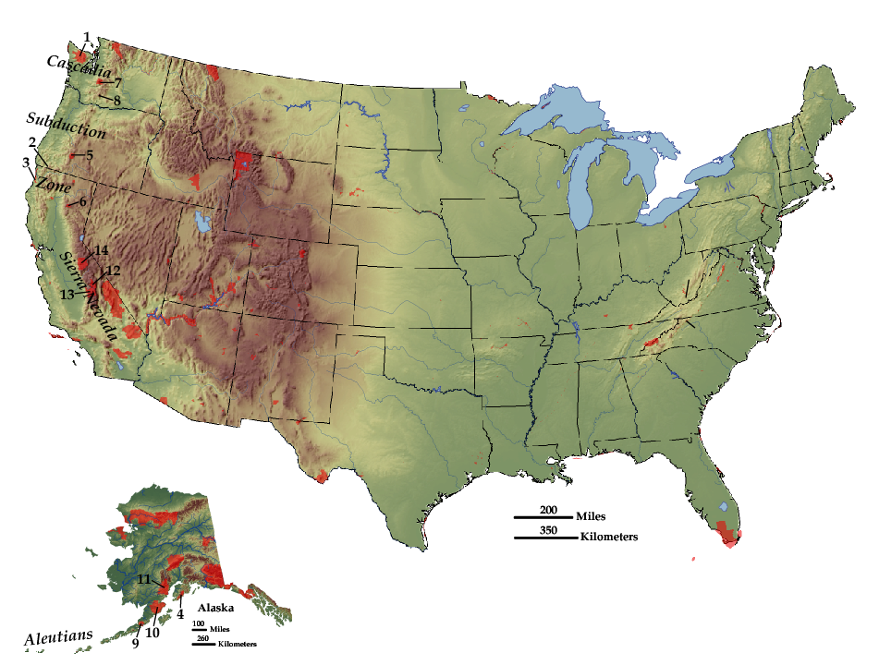
NATIONAL PARKLANDS
Active Subduction
Zones
SUBDUCTION ZONES
Parks and Plates
©2005 Robert J. Lillie
Notes:
The parks we studied in the Cascades and in Southern Alaska are in active subduction zones…

Slide 5
NATIONAL PARKLANDS
Ancient Subduction
Zone
SUBDUCTION ZONES
Parks and Plates
©2005 Robert J. Lillie
Notes:
… but the granitic rocks of Yosemite and the rest of the Sierra Nevada formed in an ancient subduction zone…

Slide 6
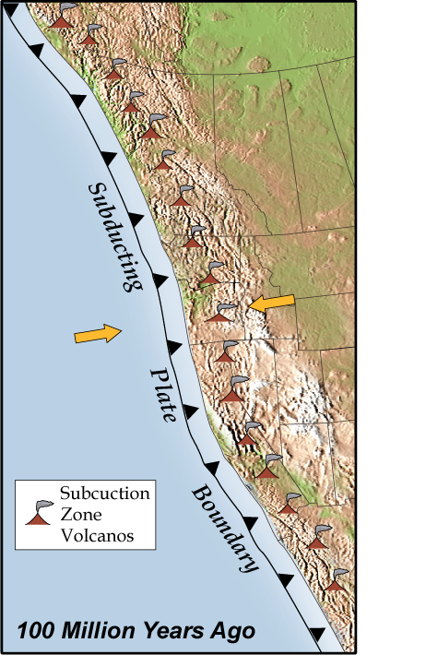
Farallon Plate
Marshak, EARTH (Norton, 2005)
Notes:
… about 100 million years ago. Like the modern Cascadian subduction zone, the ancient one involved the subduction of the Farallon Plate under the North American Plate and the development of a chain of volcanoes; only this one was much longer than the Cascades. It involved the entire west coast of North America, all the way from Northern Canada to Central Mexico.

Slide 7
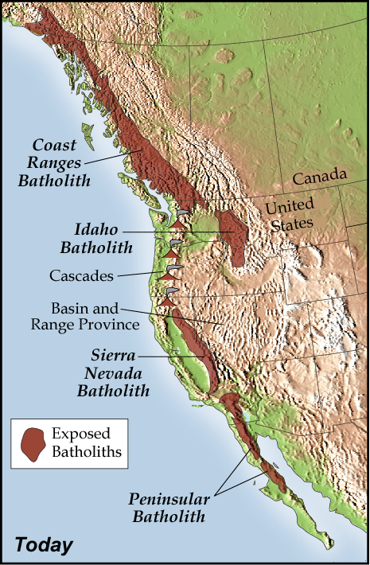
Marshak, EARTH (Norton, 2005)
Notes:
The granitic rocks of the Sierra Nevada, as well as several other western North American mountain ranges, represent the eroded remnants of magma chambers that fed the ancient volcanoes. These massive complexes of plutonic igneous rock are called batholiths. Today the Coast Ranges, Idaho, Sierra Nevada and Peninsular Ranges Batholiths are discontinuous, …

Slide 8
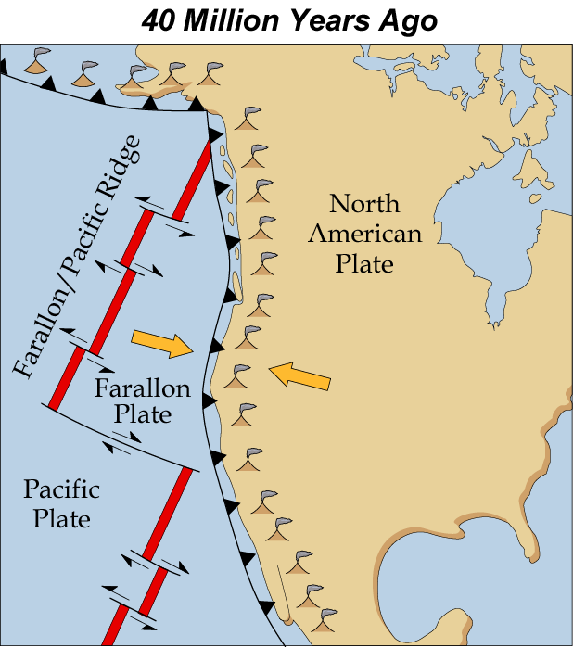
Marshak, EARTH (Norton, 2005)
Notes:
… but before the Pacific Plate encountered the edge of the North American Plate, all four batholiths may have formed a continuous plutonic root beneath the once great chain of volcanoes.

Slide 9
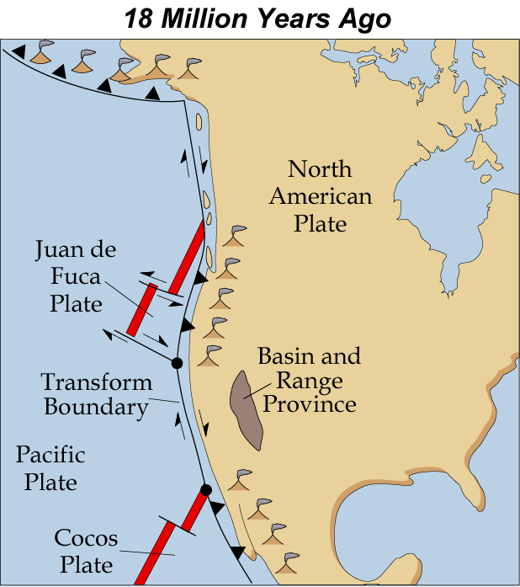
Marshak, EARTH (Norton, 2005)
Notes:
The meeting of the Pacific and North American Plates broke the chain as subduction of the Farallon Plate ended and a transform plate boundary developed. Subduction continued where fragments of the old Farallon Plate remained, now known as the Juan de Fuca and Cocos plates.

Slide 10
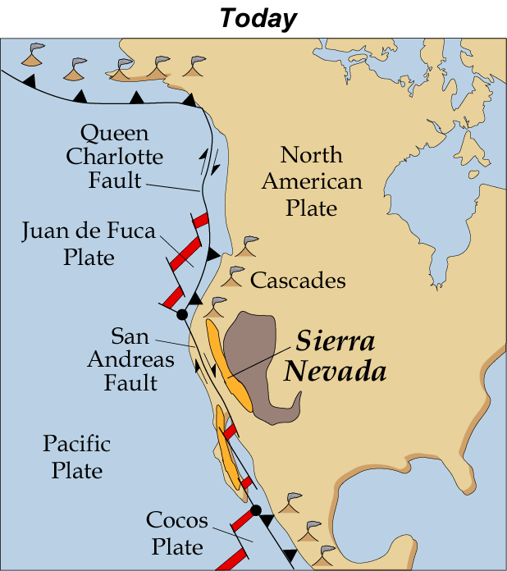
Marshak, EARTH (Norton, 2005)
Notes:
The once continuous volcanic /plutonic arc was further segmented by Basin and Range extension and San Andreas transform motion.

Slide 11
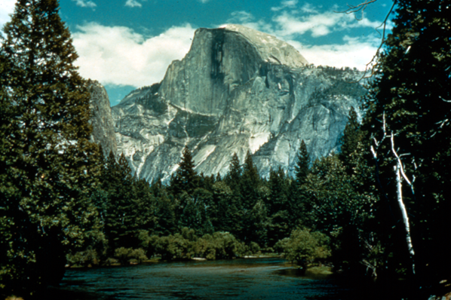
Half Dome
(Eroded Magma Chamber)
Parks and Plates
©2005 Robert J. Lillie
Notes:
So the massive granite edifices in Yosemite are the erosion-exposed magma chambers of former volcanoes …

Slide 12
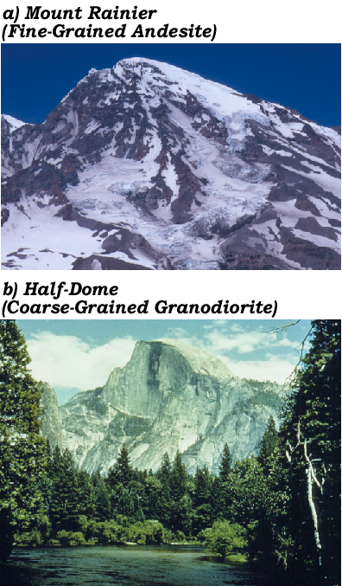
“Ancient Sierras”
Volcano
“Modern Sierras”
Magma Chamber
Notes:
…and towering composite volcanoes like Mt. Rainier stood above those magma chambers 100 million years ago.

Slide 13
Andesite
Volcano
Magma Chamber
Notes:
Like Mt. Rainier those volcanoes would have been comprised mainly of andesite – a rapidly cooled, fine-grained volcanic rock of intermediate composition.

Slide 14
Andesite
Volcano
Magma Chamber
Granodiorite
Notes:
Several kilometers beneath them, where their magma chambers cooled much more slowly - coarse grained granodiorite formed.

Slide 15
Erosion
Andesite
Volcano
Magma Chamber
Granodiorite
Notes:
As uplift occurred …

Slide 16
Erosion
Andesite
Volcano
Magma Chamber
Granodiorite
Notes:
… the volcanic rocks where eroded…

Slide 17
Erosion
Andesite
Volcano
Magma Chamber
Granodiorite

Slide 18
Andesite
Volcano
Erosion
Magma Chamber
Granodiorite

Slide 19
Andesite
Volcano
Erosion
Magma Chamber
Granodiorite
Notes:
… eventually exposing the once deeply buried plutonic rocks.

Slide 20
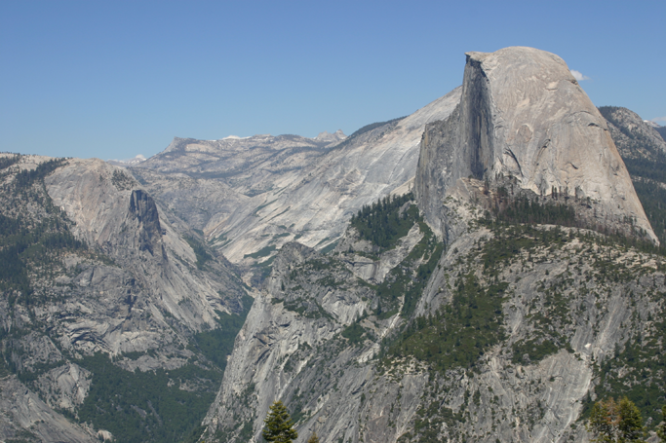
Robert J. Lillie
Parks and Plates
©2005 Robert J. Lillie
Notes:
But plutons had to intrude into something. What were those rocks like that existed before the plutons?

Slide 21
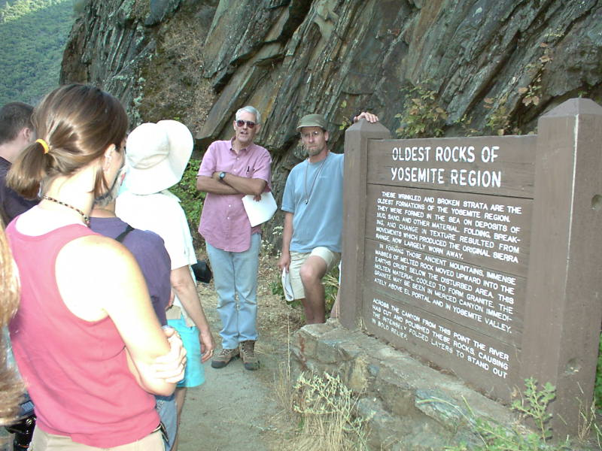
Notes:
The oldest rocks in the Yosemite region are exposed as discontinuous patches of mostly metamorphosed, folded …

Slide 22
Am I tilted enough?
Notes:
… and tilted strata.

Slide 23
PRE-BATHOLITHIC ROCKS
Quartzite, schist, marble (Late Proterozoic to early Cambrian)
“Shoo Fly Complex” – schist and gneisses of continental origin, with intrusive granites (Late Proterozoic (?) to Mid Paleozoic)
“Calaveras Complex” – a mélange of oceanic origin (Mid to late Paleozoic)
Notes:
Since these rocks are older than the plutons and the Sierra Nevada batholith is made of these plutons, we will refer to them as the pre-batholithic rocks. In Yosemite National Park, pre-batholithic rocks fall into three general types.

Slide 24
PRE-BATHOLITHIC ROCKS
Quartzite, schist, marble (Late Proterozoic to early Cambrian)
“Shoo Fly Complex” – schist and gneisses of continental origin, with intrusive granites (Late Proterozoic (?) to Mid Paleozoic)
“Calaveras Complex” – a mélange of oceanic origin (Mid to late Paleozoic)
Notes:
The oldest of these includes quartzite, schist and marble, which are the metamorphic equivalents of quartz sandstone, shale and limestone. By now you should recognize that as a typical divergent continental margin assemblage and it shouldn’t surprise you therefore that these rocks are late Proterozoic to early Cambrian in age, which is the same age as the Grand Canyon strata laid down during the first great transgression.

Slide 25
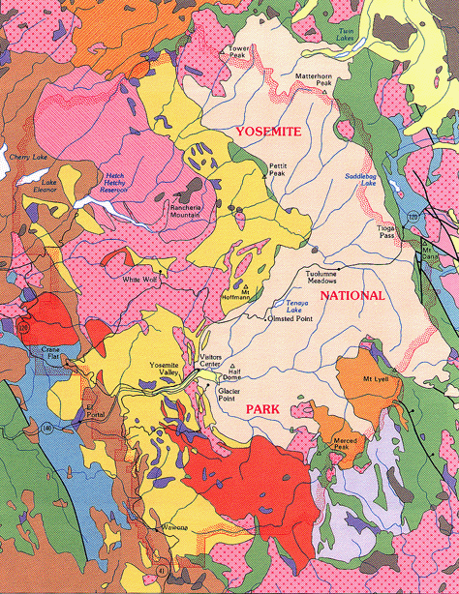
Notes:
Like most of the pre-batholithic rocks in the Yosemite area, these rocks outcrop mostly on the western and eastern margins of the park. Shown in green and blue in this geologic map, the pre-batholithic rocks represent “roof pendants” – meaning portions of the roof of the old magma chamber that sagged-down like pendants into the magma.

Slide 26
PRE-BATHOLITHIC ROCKS
Quartzite, schist, marble (Late Proterozoic to early Cambrian)
“Shoo Fly Complex” – schist and gneisses of continental origin, with intrusive granites (Late Proterozoic (?) to Mid Paleozoic)
“Calaveras Complex” – a mélange of oceanic origin (Mid to late Paleozoic)
Notes:
In addition to the afore mentioned DCM sediments, two other pre-batholithic rock groups exist in the Yosemite area. The first of these, the “Shoofly Complex” suggests that west coast orogeny started early in the Paleozoic and perhaps even as far back as the late Proterozoic, because its schists and gneisses are derived from the erosion of continental sources (implying mountain building) and are intruded by Paleozoic granites.

Slide 27
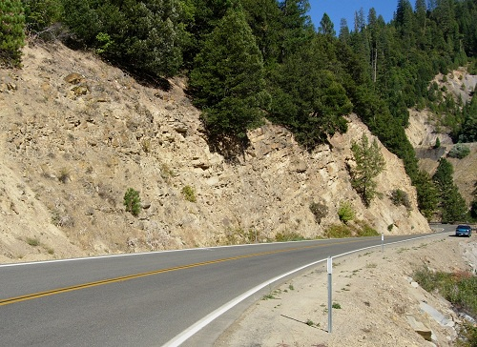
Notes:
Where the Shoofly Complex is not severely metamorphosed …

Slide 28
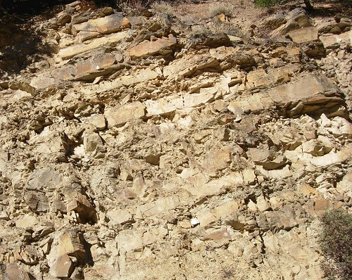
Shoo Fly
Notes:
… it is reminiscent of the flysch deposits of the Valdez Group in Kenai Fjords National Park. Recall that flysch is a syn-orogenic sediment - meaning that it deposits at the same time as orogeny.

Slide 29
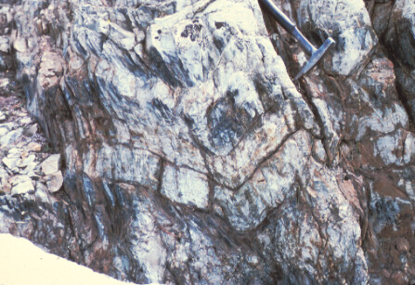
Shoo Fly fold with axial plane foliation
-------foliation-------
Notes:
In most places the Shoo Fly Complex is folded and metamorphosed with a strong foliation developed perpendicular to the direction of compression.

Slide 30
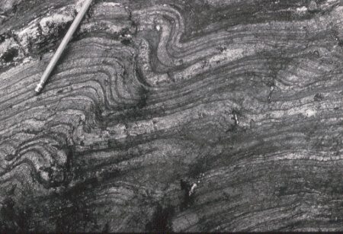
Refolded Shoo Fly
Notes:
It is also typically refolded, indicating that it was affected by more than one orogeny.

Slide 31
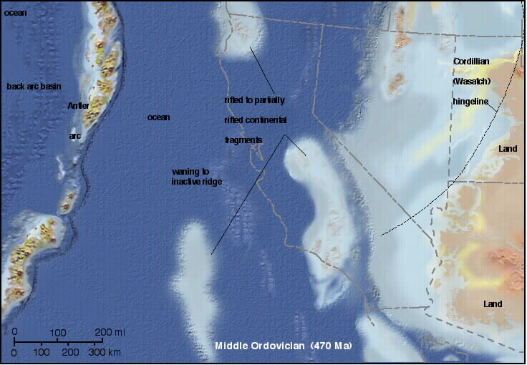
Notes:
Such would be the case if the Shoo Fly Complex originated from the Paleozoic collision and amalgamation of rifted continental fragments …

Slide 32
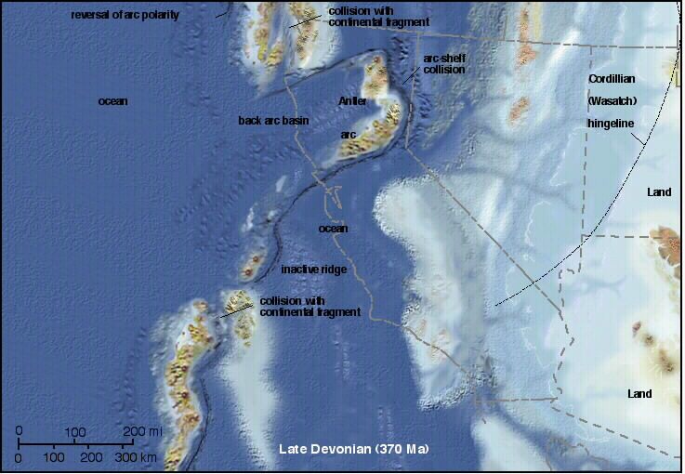
Notes:
…and island arc material …

Slide 33
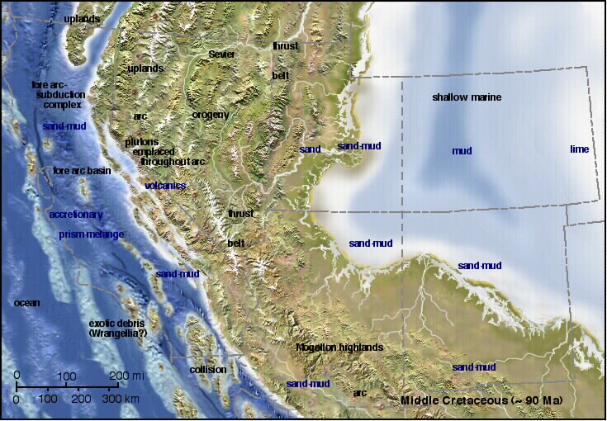
Notes:
… that were re-compressed during the Mesozoic as various other terranes accreted to the western edge of North America. Anyway, that’s one interpretation. With all those terranes moving about off western North America, there’s a lot of room for interpretation.

Slide 34
PRE-BATHOLITHIC ROCKS
Quartzite, schist, marble (Late Proterozoic to early Cambrian)
“Shoofly Complex” – schist and gneisses of continental origin, with intrusive granites (Late Proterozoic (?) to Mid Paleozoic)
“Calaveras Complex” – a mélange of oceanic origin (Mid to late Paleozoic)
Notes:
With all that Paleozoic orogeny, it follows that somewhere subduction was busy making mélange. The Calaveras Complex represents that mélange. The mid to late Paleozoic Calaveras Complex …

Slide 35
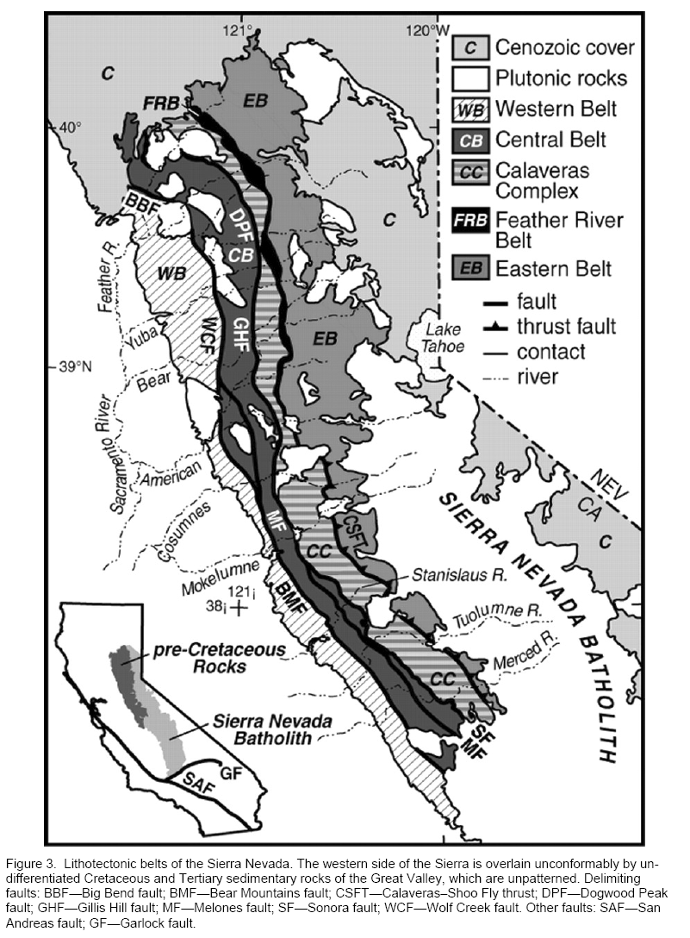
Yosemite
Notes:
… highlighted here is thrust under the older Shoo Fly Complex along the Calaveras - Shoo Fly Thrust (CSFT) in typical mélange fashion.

Slide 36
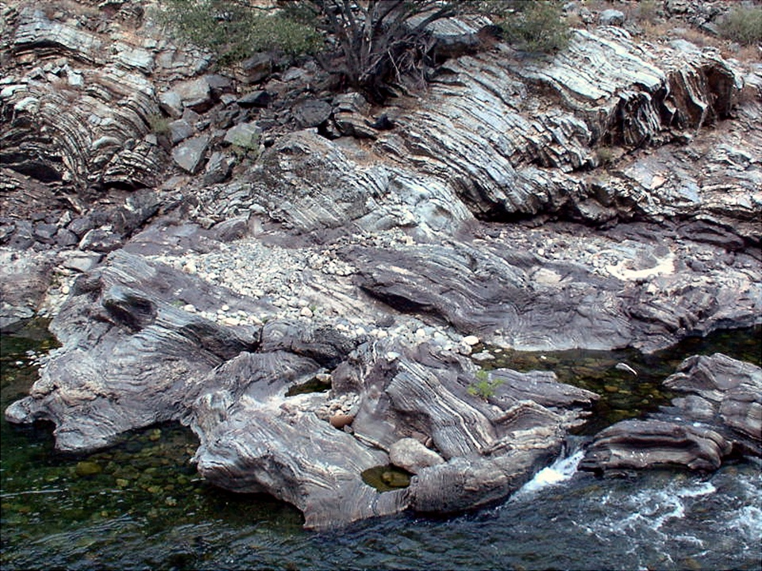
Notes:
Here we see the banded chert and phyllite (metamorphosed mud) of the Calaveras Complex exposed along the Merced River that flows through Yosemite. Note the contorted folding typical of mélange rocks …

Slide 37
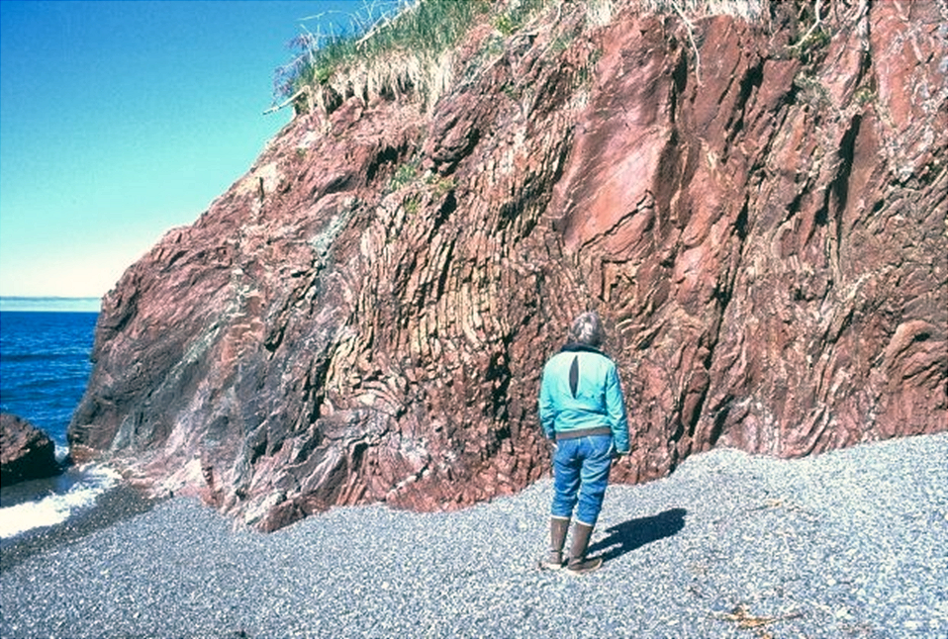
Radiolarian Chert – McHugh Complex
Notes:
… and reminiscent of the McHugh Complex in Kenai Fjords National Park …

Slide 38
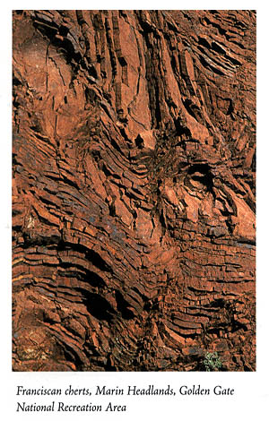
Notes:
… and the Franciscan Complex in Redwoods National Park.

Slide 39
SYN-BATHOLITHIC ROCKS
Triassic to Jurassic
Volcanic and volcano-sedimentary
Represent volcanic activity above plutons
Notes:
OK, I know you’re anxious to get to the main event, the formation of the Sierra Nevada Batholith, but we have one more stop to make first. There’s a significant amount of rock in and around the park that formed at about the same time as the batholith. These “syn-batholithic rocks are…

Slide 40
SYN-BATHOLITHIC ROCKS
Triassic to Jurassic
Volcanic and volcano-sedimentary
Represent volcanic activity above plutons
Notes:
…Triassic to Jurassic in age, …

Slide 41
SYN-BATHOLITHIC ROCKS
Triassic to Jurassic
Volcanic and volcano-sedimentary
Represent volcanic activity above plutons
Notes:
… generally volcanic and sedimentary rocks derived form volcanic rocks, …

Slide 42
SYN-BATHOLITHIC ROCKS
Triassic to Jurassic
Volcanic and volcano-sedimentary
Represent volcanic activity above plutons
Notes:
… and represent volcanic activity taking place above the plutons which comprise the batholith.

Slide 43
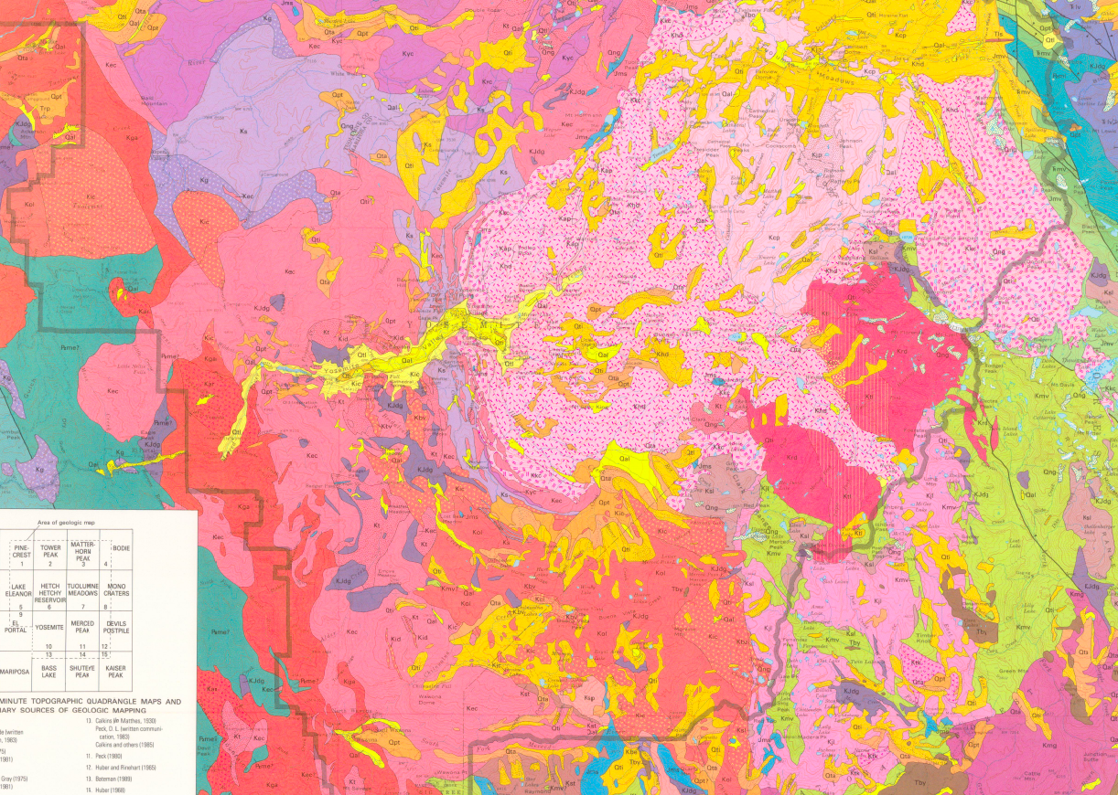
Yosemite Valley
Notes:
Shown in various shades of green on this geologic map, like the pre-batholithic rocks, the syn-batholithic rock’s outcrops are discontinuous and occur mainly as roof pendants.

Slide 44
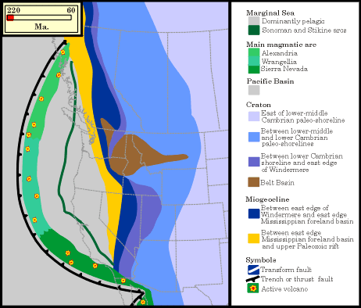
Main Sierran volcanic arc
Notes:
This interpretation of Mesozoic paleogeography suggests that the syn-batholithic volcanic rocks in Yosemite represent the southern portion of an extensive volcanic arc that existed well westward of the continent’s western margin.

Slide 45
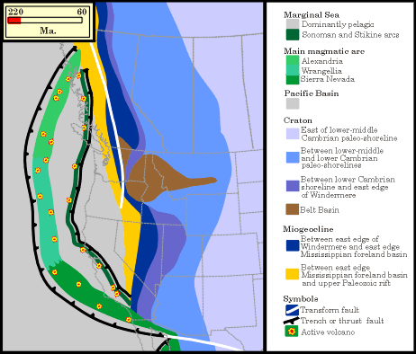
Secondary volcanic arc
Main Sierran volcanic arc
Notes:
By Jurassic time a second volcanic arc existed between the main Sierran arc and the continent’s edge.

Slide 46
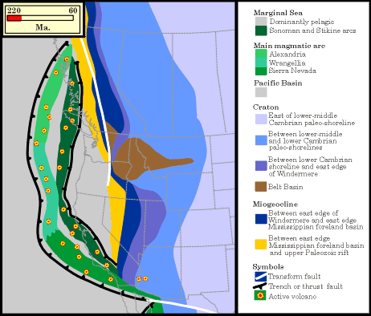
Secondary volcanic arc
Main Sierran volcanic rocks
Notes:
As subduction progressed, compression and associated thrust faulting brought the two arcs closer …

Slide 47
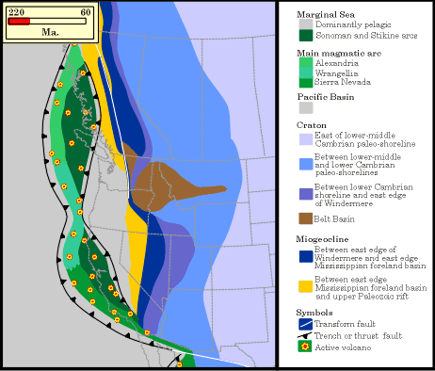
Secondary volcanic arc
Main Sierran volcanic rocks
Notes:
.. .fused them together …

Slide 48
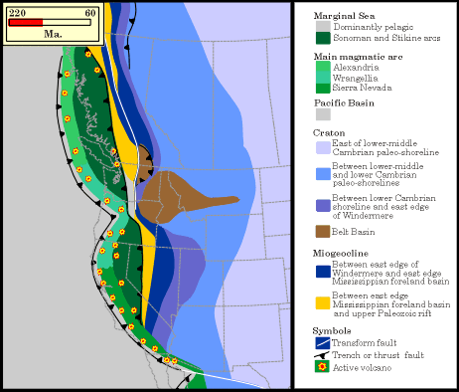
Secondary volcanic arc
Main Sierran volcanic rocks
Notes:
… and accreted them to the North American Plate.

Slide 49
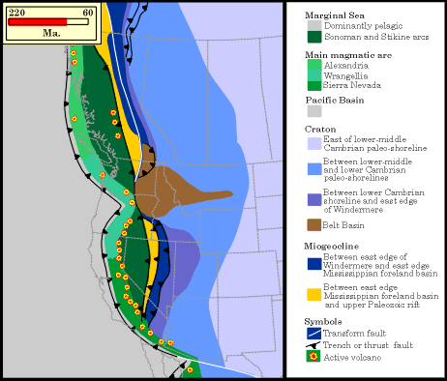
Secondary volcanic arc
Main Sierran volcanic rocks
Notes:
By Cretaceous time, subduction had changed from ocean-ocean to ocean-continent.

Slide 50
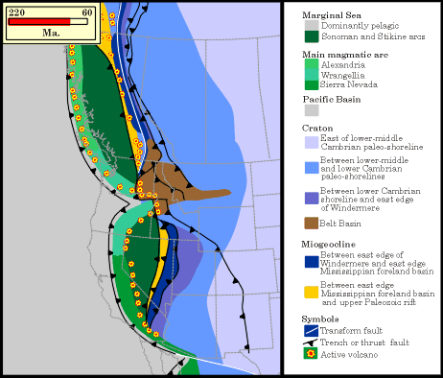
Secondary volcanic arc
Main Sierran volcanic rocks
Notes:
Continued compression tightened up the newly accreted continental margin while a shallowing subduction angle caused arc magmatism to migrate eastward…

Slide 51
Foreland folding
Secondary volcanic arc
Main Sierran volcanic rocks
Notes:
… along with associated foreland folding …

Slide 52
Thrust faulting
Secondary volcanic arc
Main Sierran volcanic rocks
Notes:
… and thrust faulting.

Slide 53
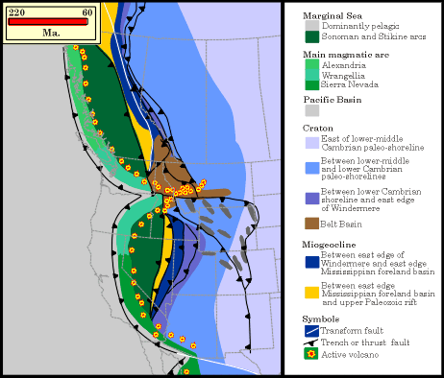
Secondary volcanic arc
Main Sierran volcanic rocks
Notes:
By the early Cenozoic, active arc magmatism had completely left the Yosemite area.

